Slide 1
Data Visualization
Adrian Gallard | Digital Learning Data Analyst

Slide 2
Agenda
Why visuals matter
Useful Tools & Resources
Exploring, Interpreting, & Reporting

Slide 3

Why Visuals Matter

Slide 4


Human vs. Machine
Human
Machine
Good at “seeing” data
Needs data formatted into objects
Understands space & time
Good at “reading” data
Needs data formatted in rows and columns
Doesn’t have any inherent understanding of data

Slide 5
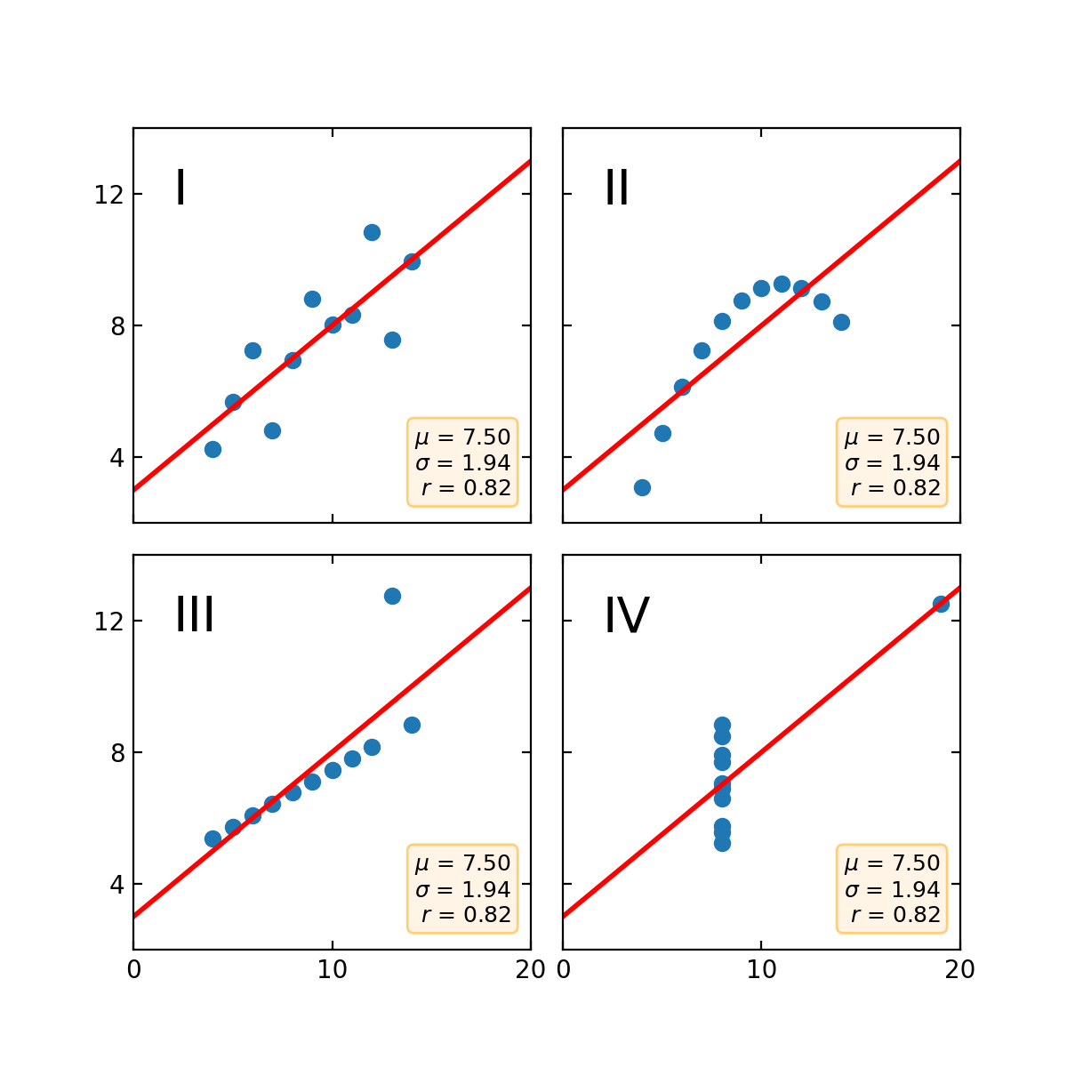
Anscombe’s Quartet
SUMMARY STATISTICS ARE NOT ENOUGH!!!
Regression Fits Data
Data is Non-Linear
Data contains outliers
Data contains outliers
(from another angle)

Slide 6
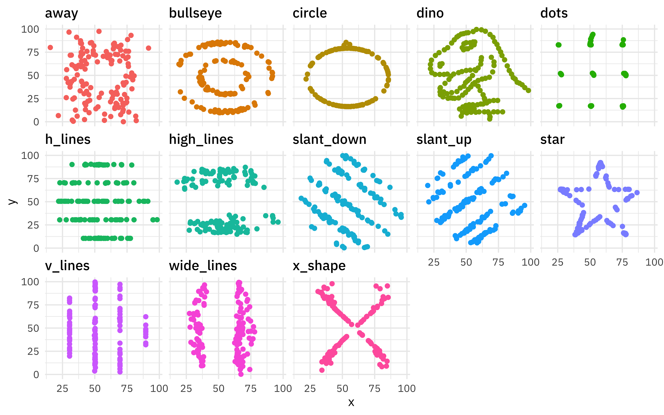
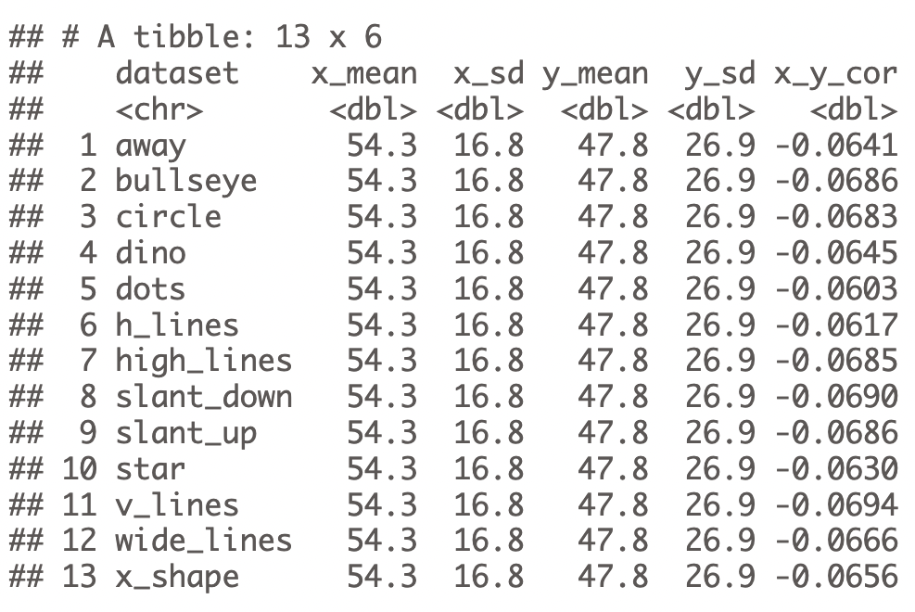
Datasaurus & Friends
SUMMARY STATISTICS ARE NOT ENOUGH!!!

Slide 7




Explore Interpret Report

Slide 8



Explore, Interpret, Report
Explore
Use visuals to understand data
Interpret
Use visuals to explain data
Report
Use visuals to summarize data

Slide 9
Explore

Slide 10
Picture your data
Look through your data and turn it into Visuals ASAP
Visualization should be a core part of Data Exploration

Slide 11
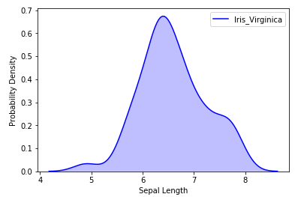
Distributions
Tell us how the data is spread out
Can show if data leans in a particular direction or if it’s normally distributed

Slide 12
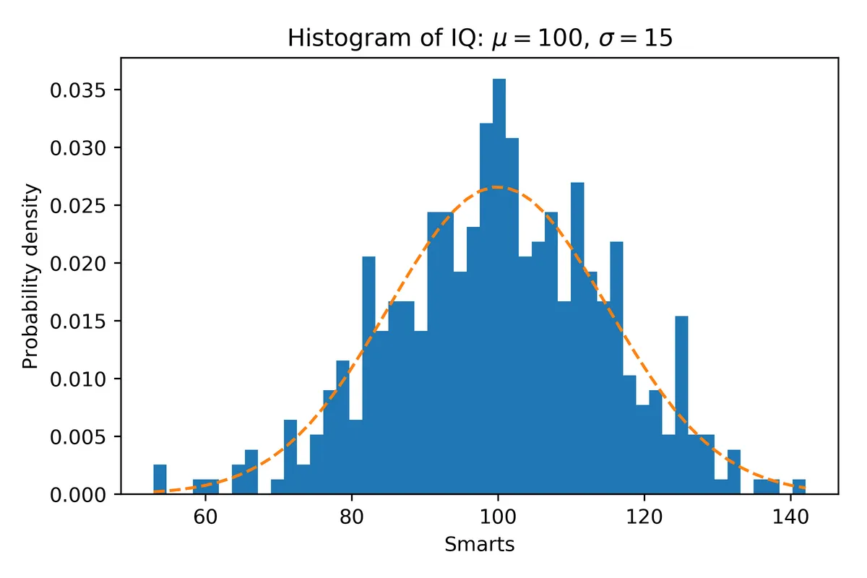
Frequencies
Shows distribution with discrete numbers
Essentially the same as Distributions
A distribution can be inferred through Histograms

Slide 13
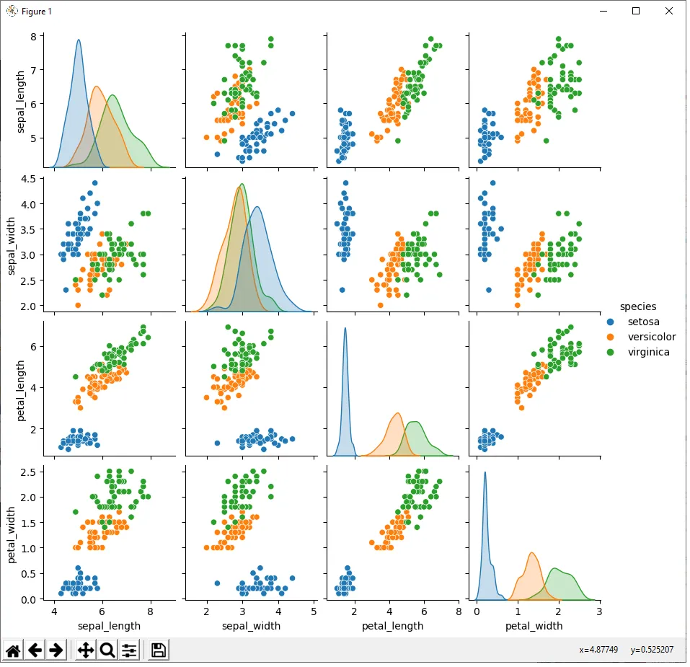
Relationships
pair-plots can show a clear relationships between features

Slide 14
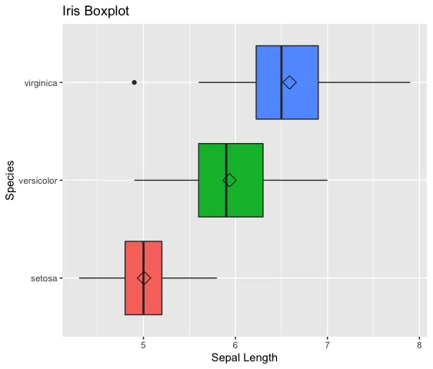
Outliers
Boxplots are an excellent way to identify outliers within a dataset
You can use violin-plots for more detail

Slide 15
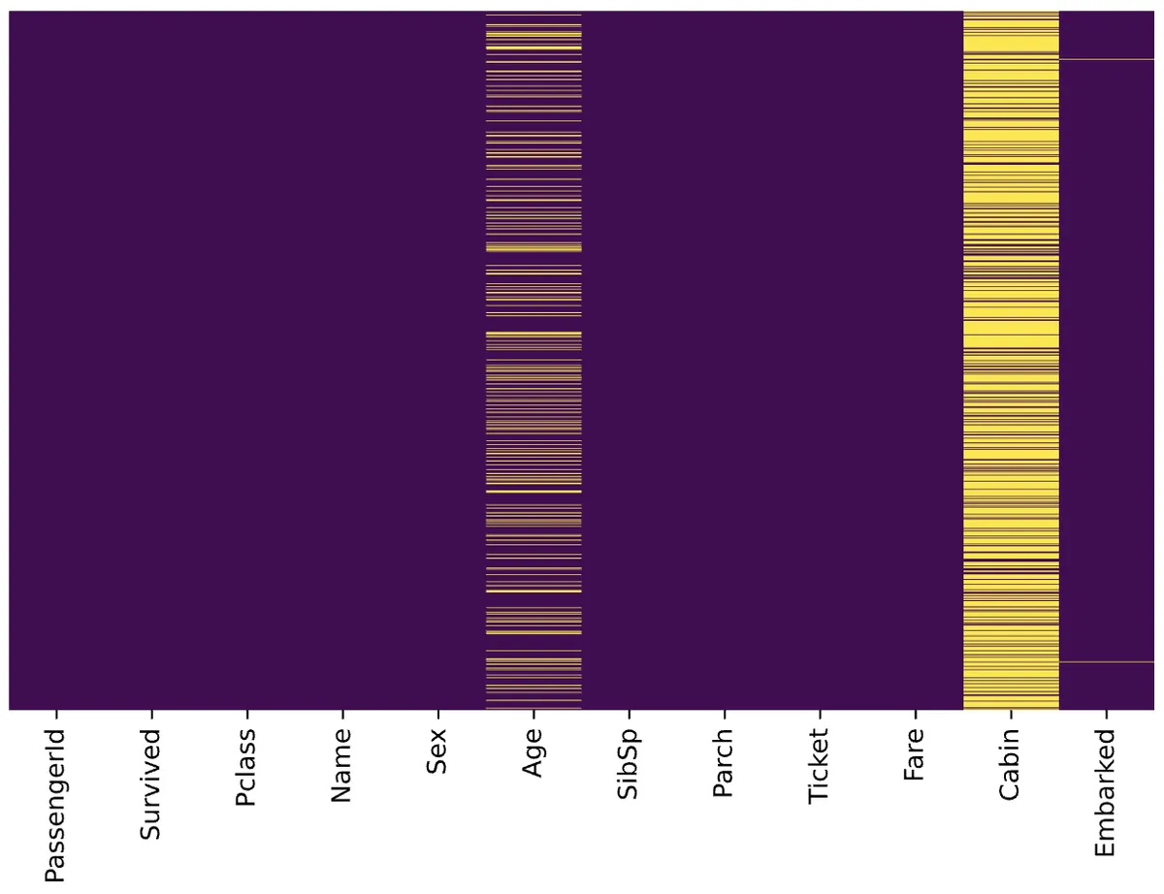
Missing Values
Heatmaps can be used to visualize missing values and their impact on a dataset

Slide 16
Interpret

Slide 17
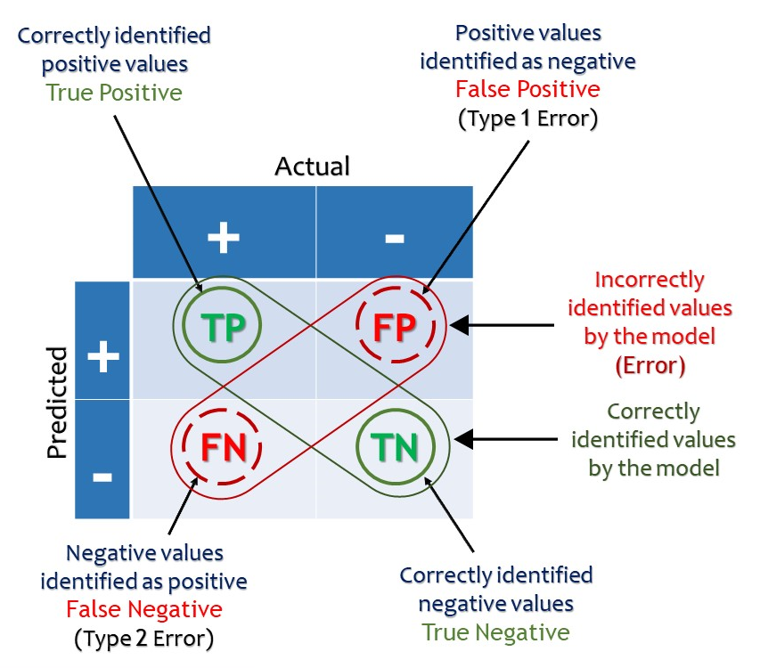
What were the Results?: Confusion Matrix

Slide 18
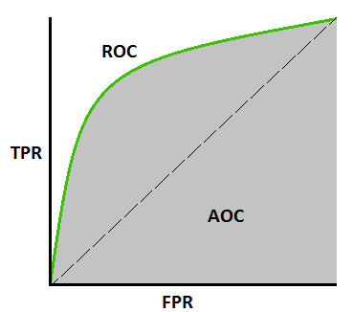
Which Model fits Best? : ROC / AUC
Receiver Operating Characteristic (ROC):
Compares True Positive & False Positive Rates to gauge how well a model fits to the data
Area Under the Curve (AUC):
The amount of space covered by the ROC Curve which indicates how well the model fits

Slide 19
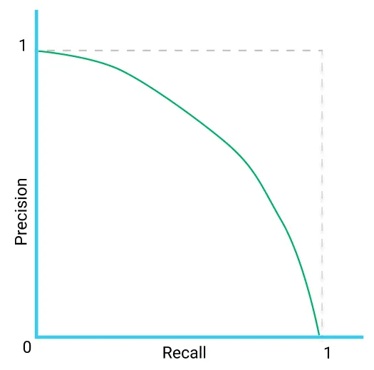
Which Model fits Best? : Precision-Recall Curve
Precision-Recall Curve:
Similar to ROC/AUC but uses Precision instead of FPR (also known as Fallout)
Precision is number of true positives out of all positive predictions (TP/P)
Recall is the number of true positives out of all true positives and false negatives (TP/TP + FN)

Slide 20
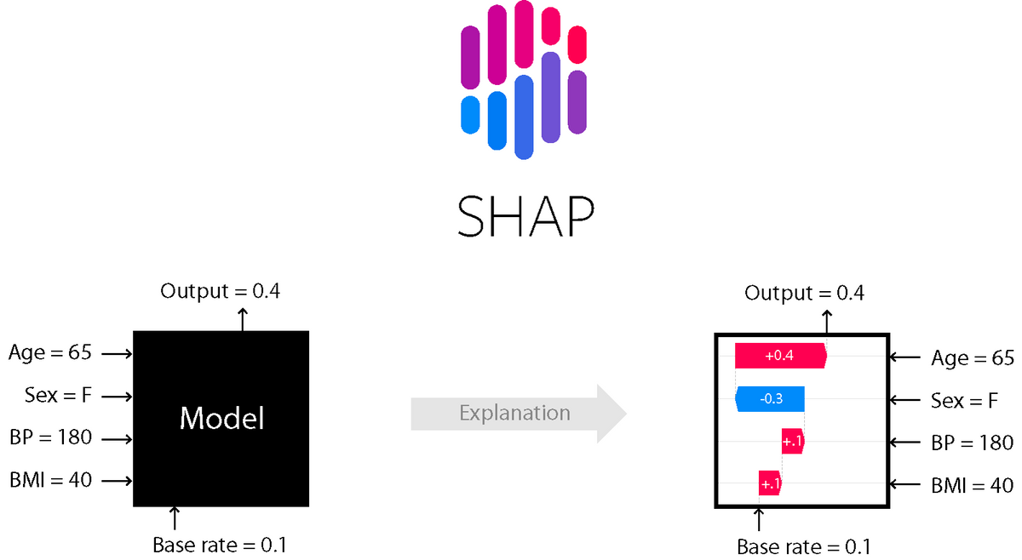
How Does the Model Work?
Shapley Additive Values are a model agnostic method for interpreting model outputs

Slide 21
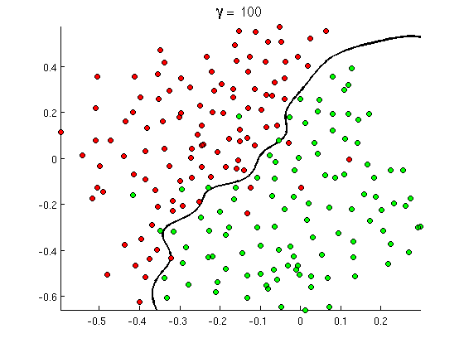
How Does the Model Work?
You can visualize the decision boundaries for a given model
If you have lots of features you can use Principal Component Analysis (PCA) to create a 2D representation of the data

Slide 22
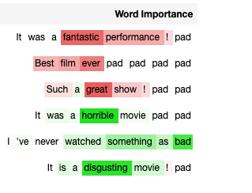
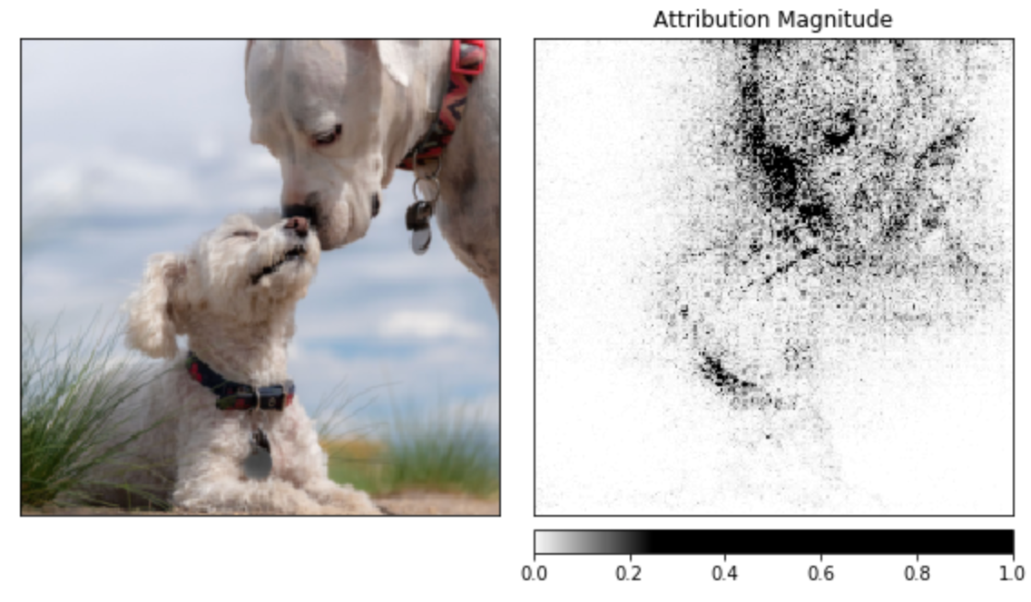
What is the model Looking at?:
Image uses captum.ai for PyTorch

Slide 23
Report

Slide 24
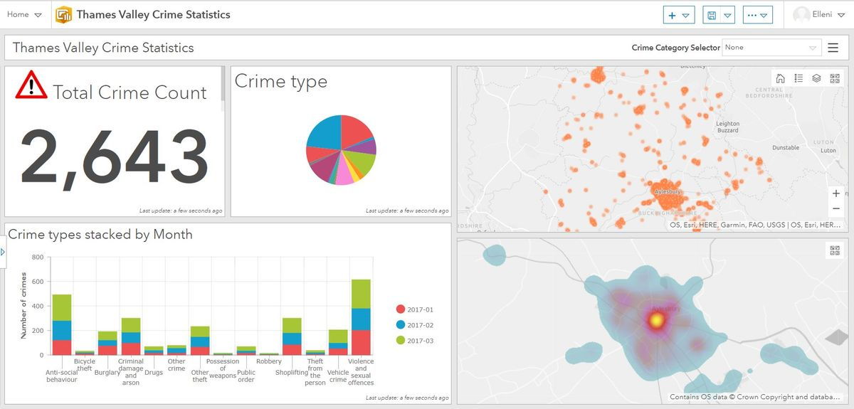
Big Picture | ”Storytelling”

Slide 25
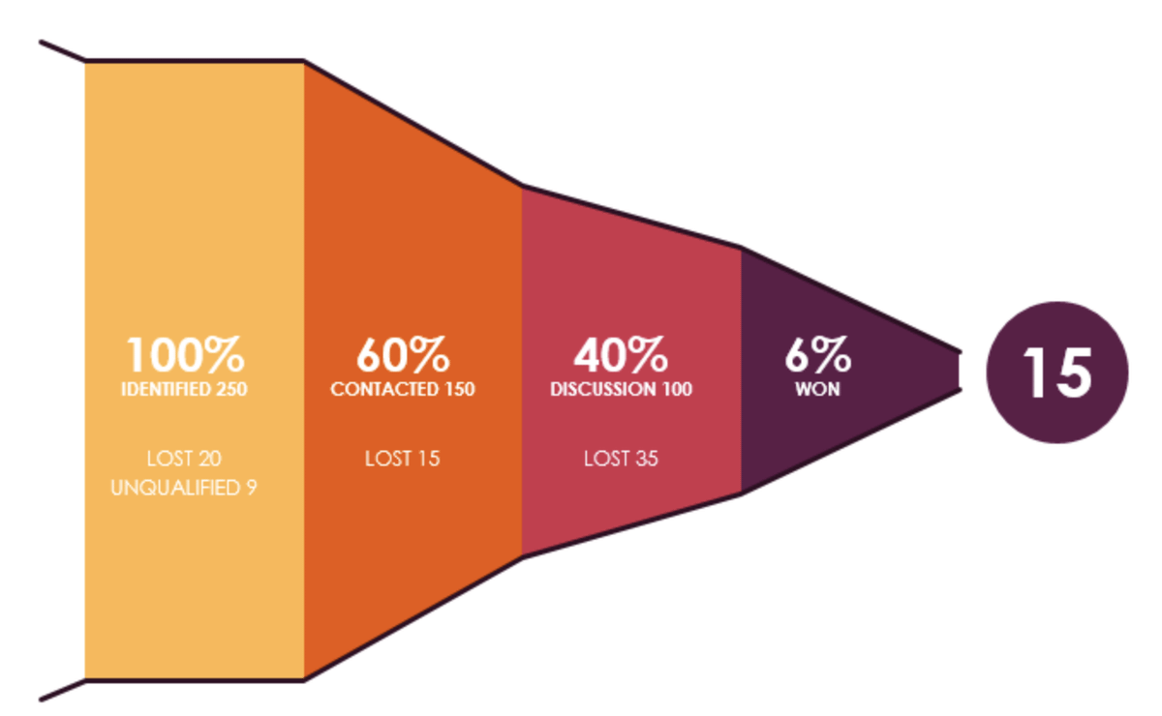
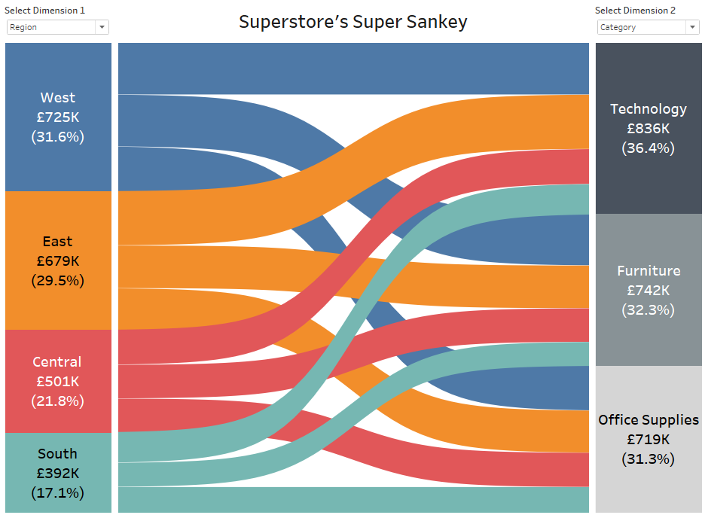
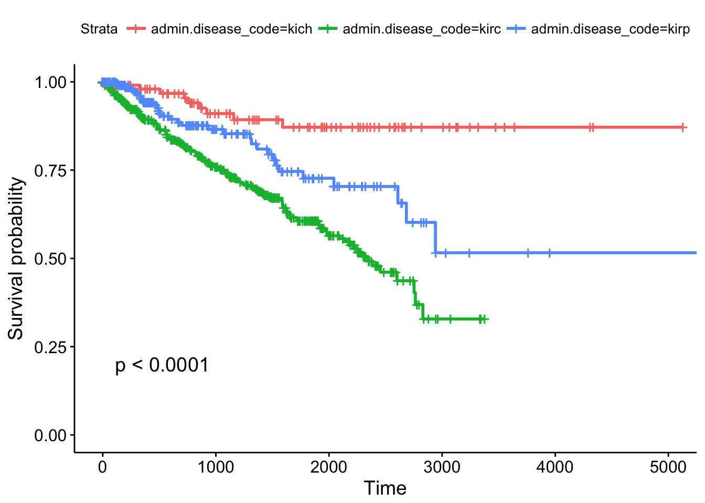
Other Data Displays

Slide 26
Things to Consider…
Key Performance Indicators (KPIs)
Basic Charts work Best (Lines & Bars)
Maintain consistent schemes throughout any report
Add any important discoveries as footnotes within report
Anticipate potential end user questions and investigations

Slide 27
End User
ALWAYS keep the End User in mind
Make sure you understand your data
Your work is a platform for others to make decisions on

Slide 28

Useful Tools & Resources

Slide 29
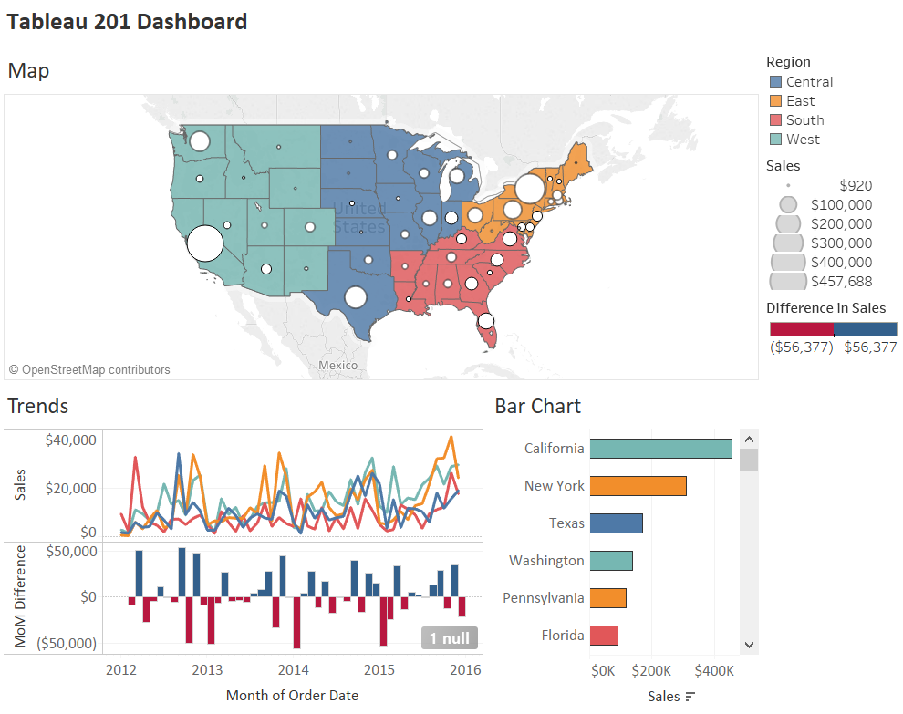
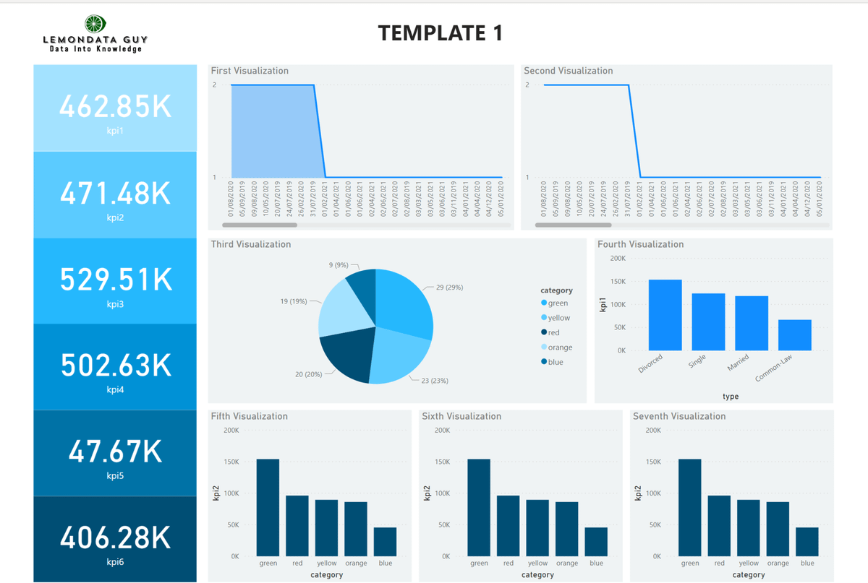


Business Intelligence

Slide 30




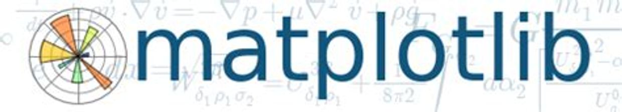
Python

Slide 31






IDE’s & Notebooks

Slide 32
Final Thoughts
Work on your workflow
Explore new ways to explore
Communicate with your End User

Slide 33
Questions?
Adrian Gallard | Digital Learning Data Analyst
agallard3@lavabit.com
https://github.com/ajgallard/vip

